Slide 1
GRAPH2SEQ: GRAPH TO SEQUENCE LEARNING WITH ATTENTION-BASED NEURAL NETWORKS
ICLR 2019 Conference
Kun Xu, Lingfei Wu, Zhiguo Wang, Yansong Feng, Michael Witbrock, Vadim Sheinin
2020-04-02
JuHyoung Kim
kjhkjh75@naver.com

Slide 2
- Process
Read Paper
Understand and run the code
Apply idea to code

Slide 3
- Problem
Studying tensorflow
Tensorflow version issue.
Many errors with running

Slide 4
- Version issue
Most Code in 1.x in tensorflow can be used with tensorflow.compat.v1
Tf.contrib was be deleted.

Slide 5
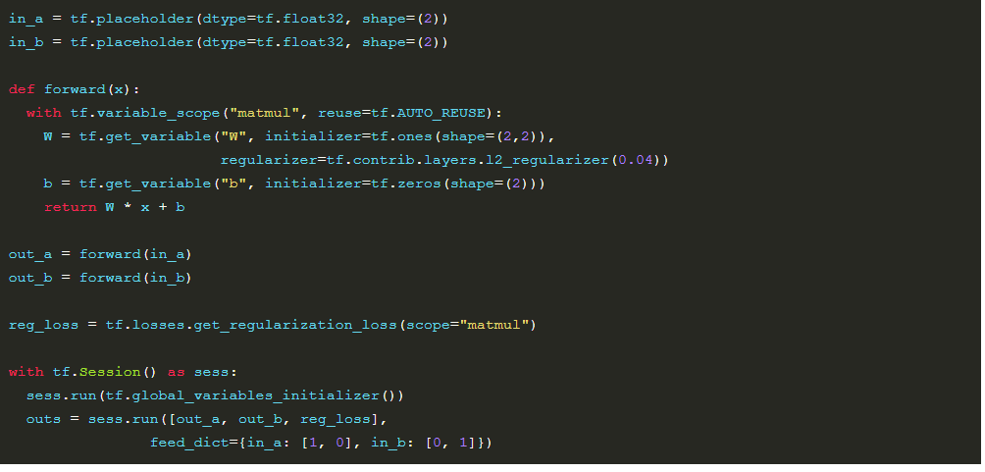
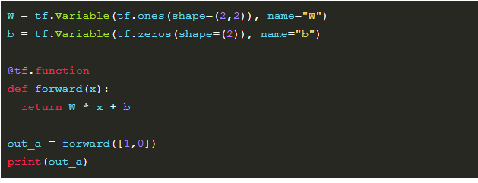
- Version issue
- tf.placeholder & tf.Session

Slide 6
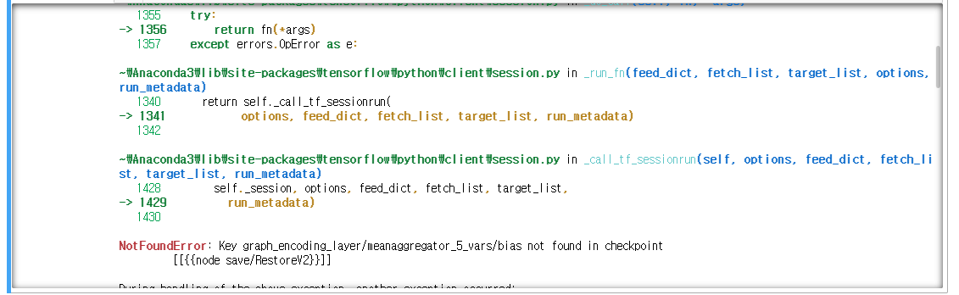
- Error issue
- Run the test session.

Slide 7
Future work.
Study two version
Decide change to 2.x or use 1.x
Apply code to source code version.

